Slide 1

KN 251 Practice Lab Practical Examination
Fall 2018

Slide 2
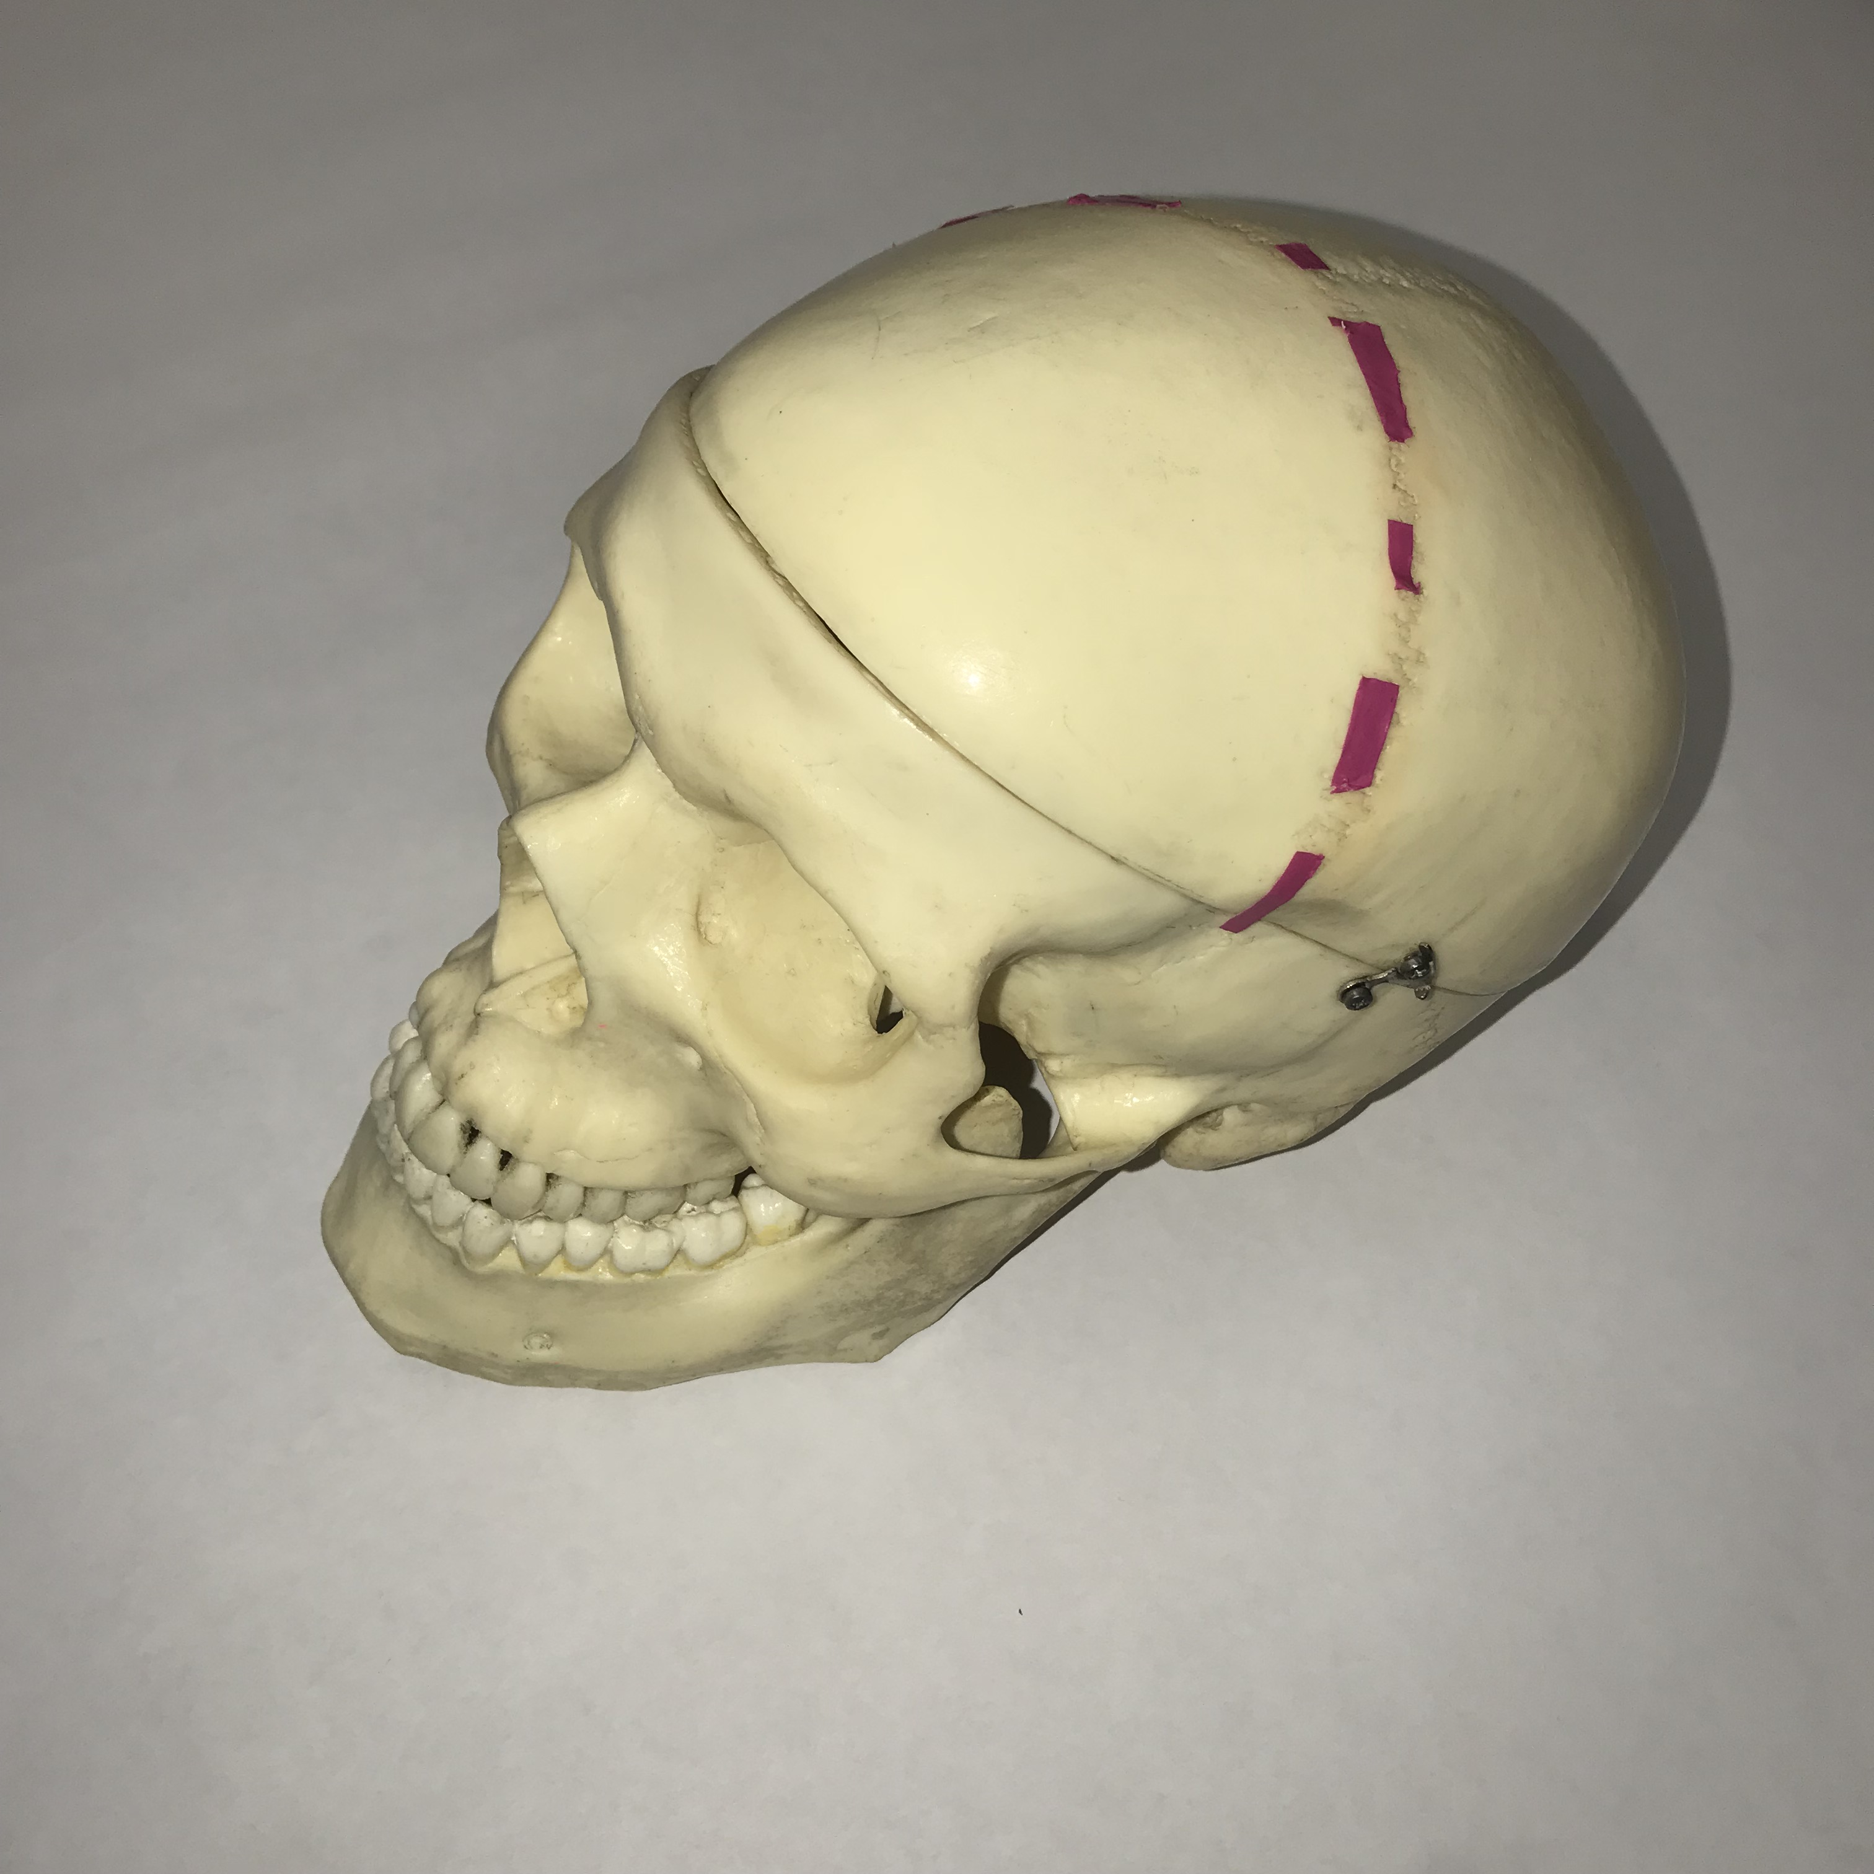
#1: Name this bony feature.

Slide 3
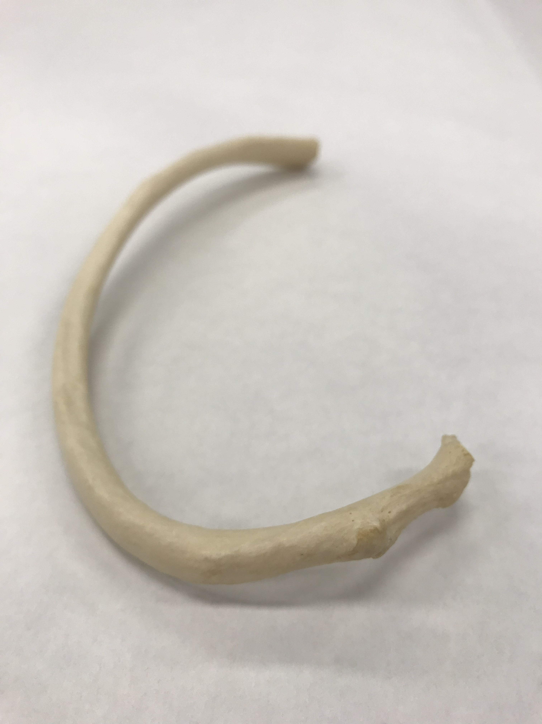
#2: Name this bony feature.

Slide 4
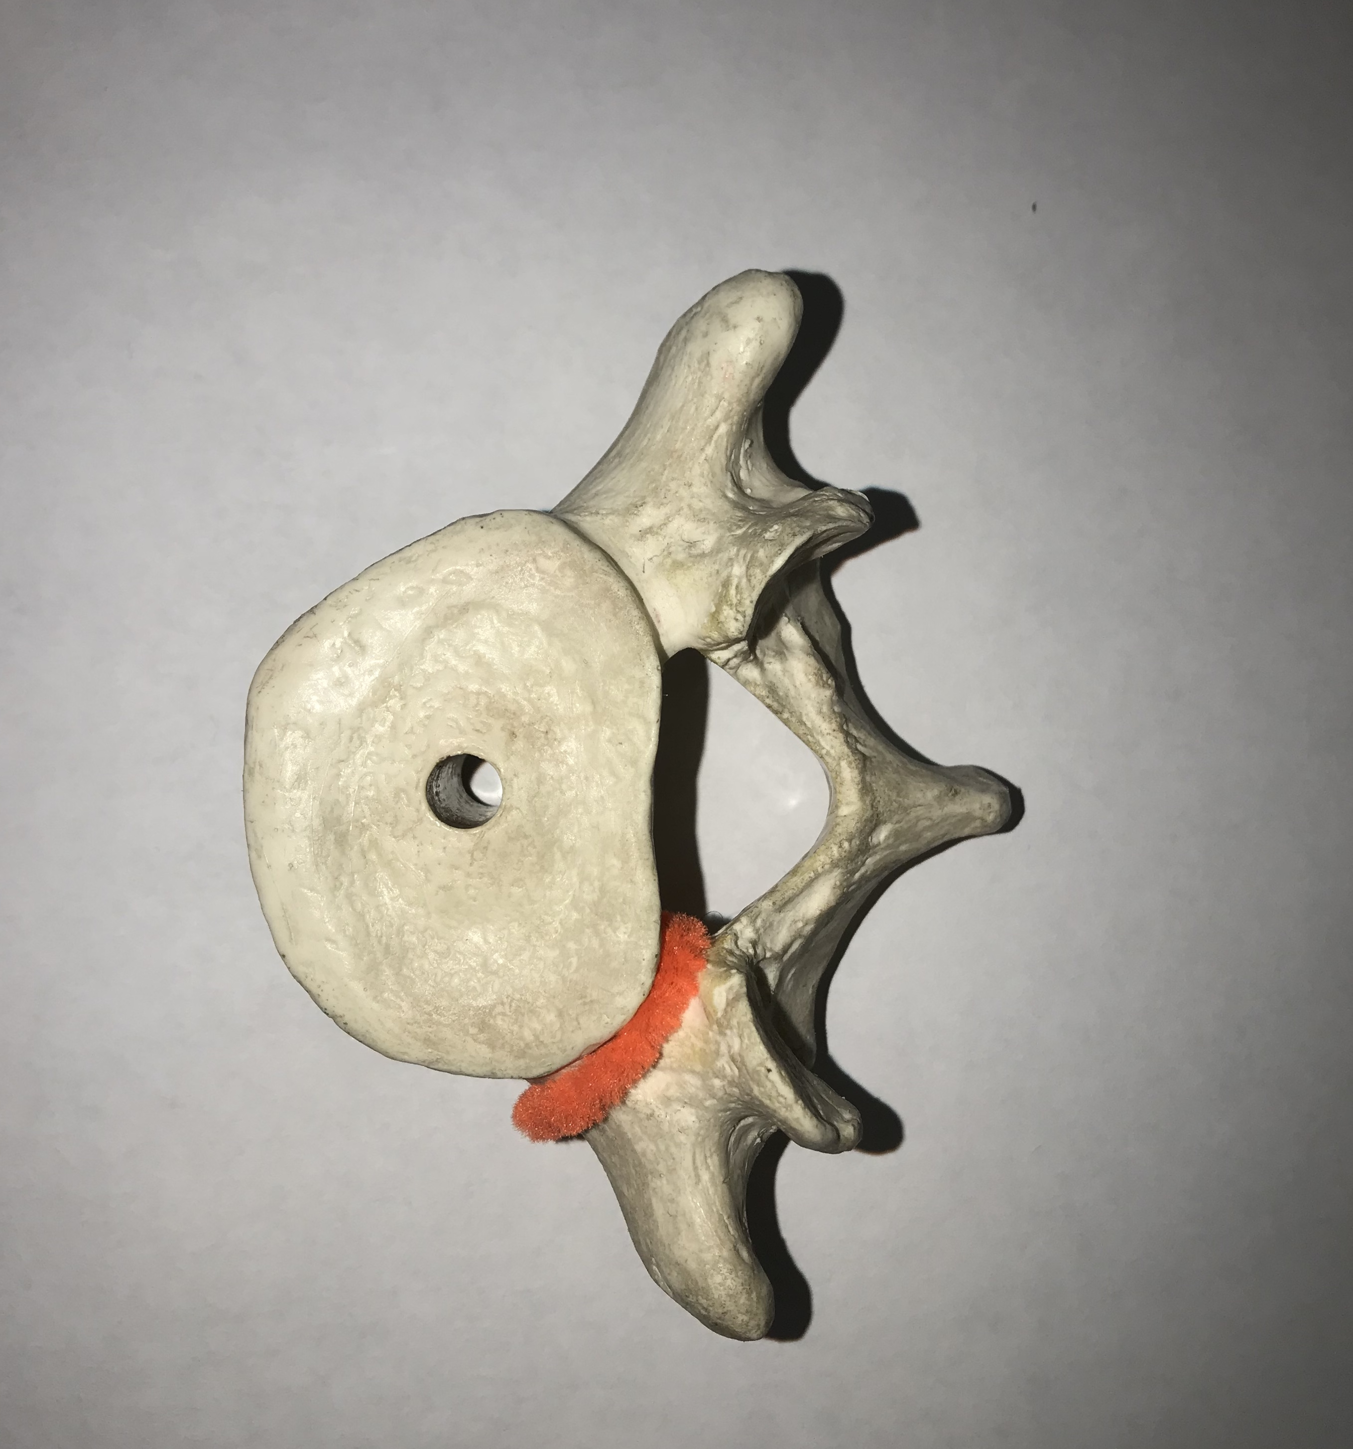
#3: Name this bony feature.

Slide 5
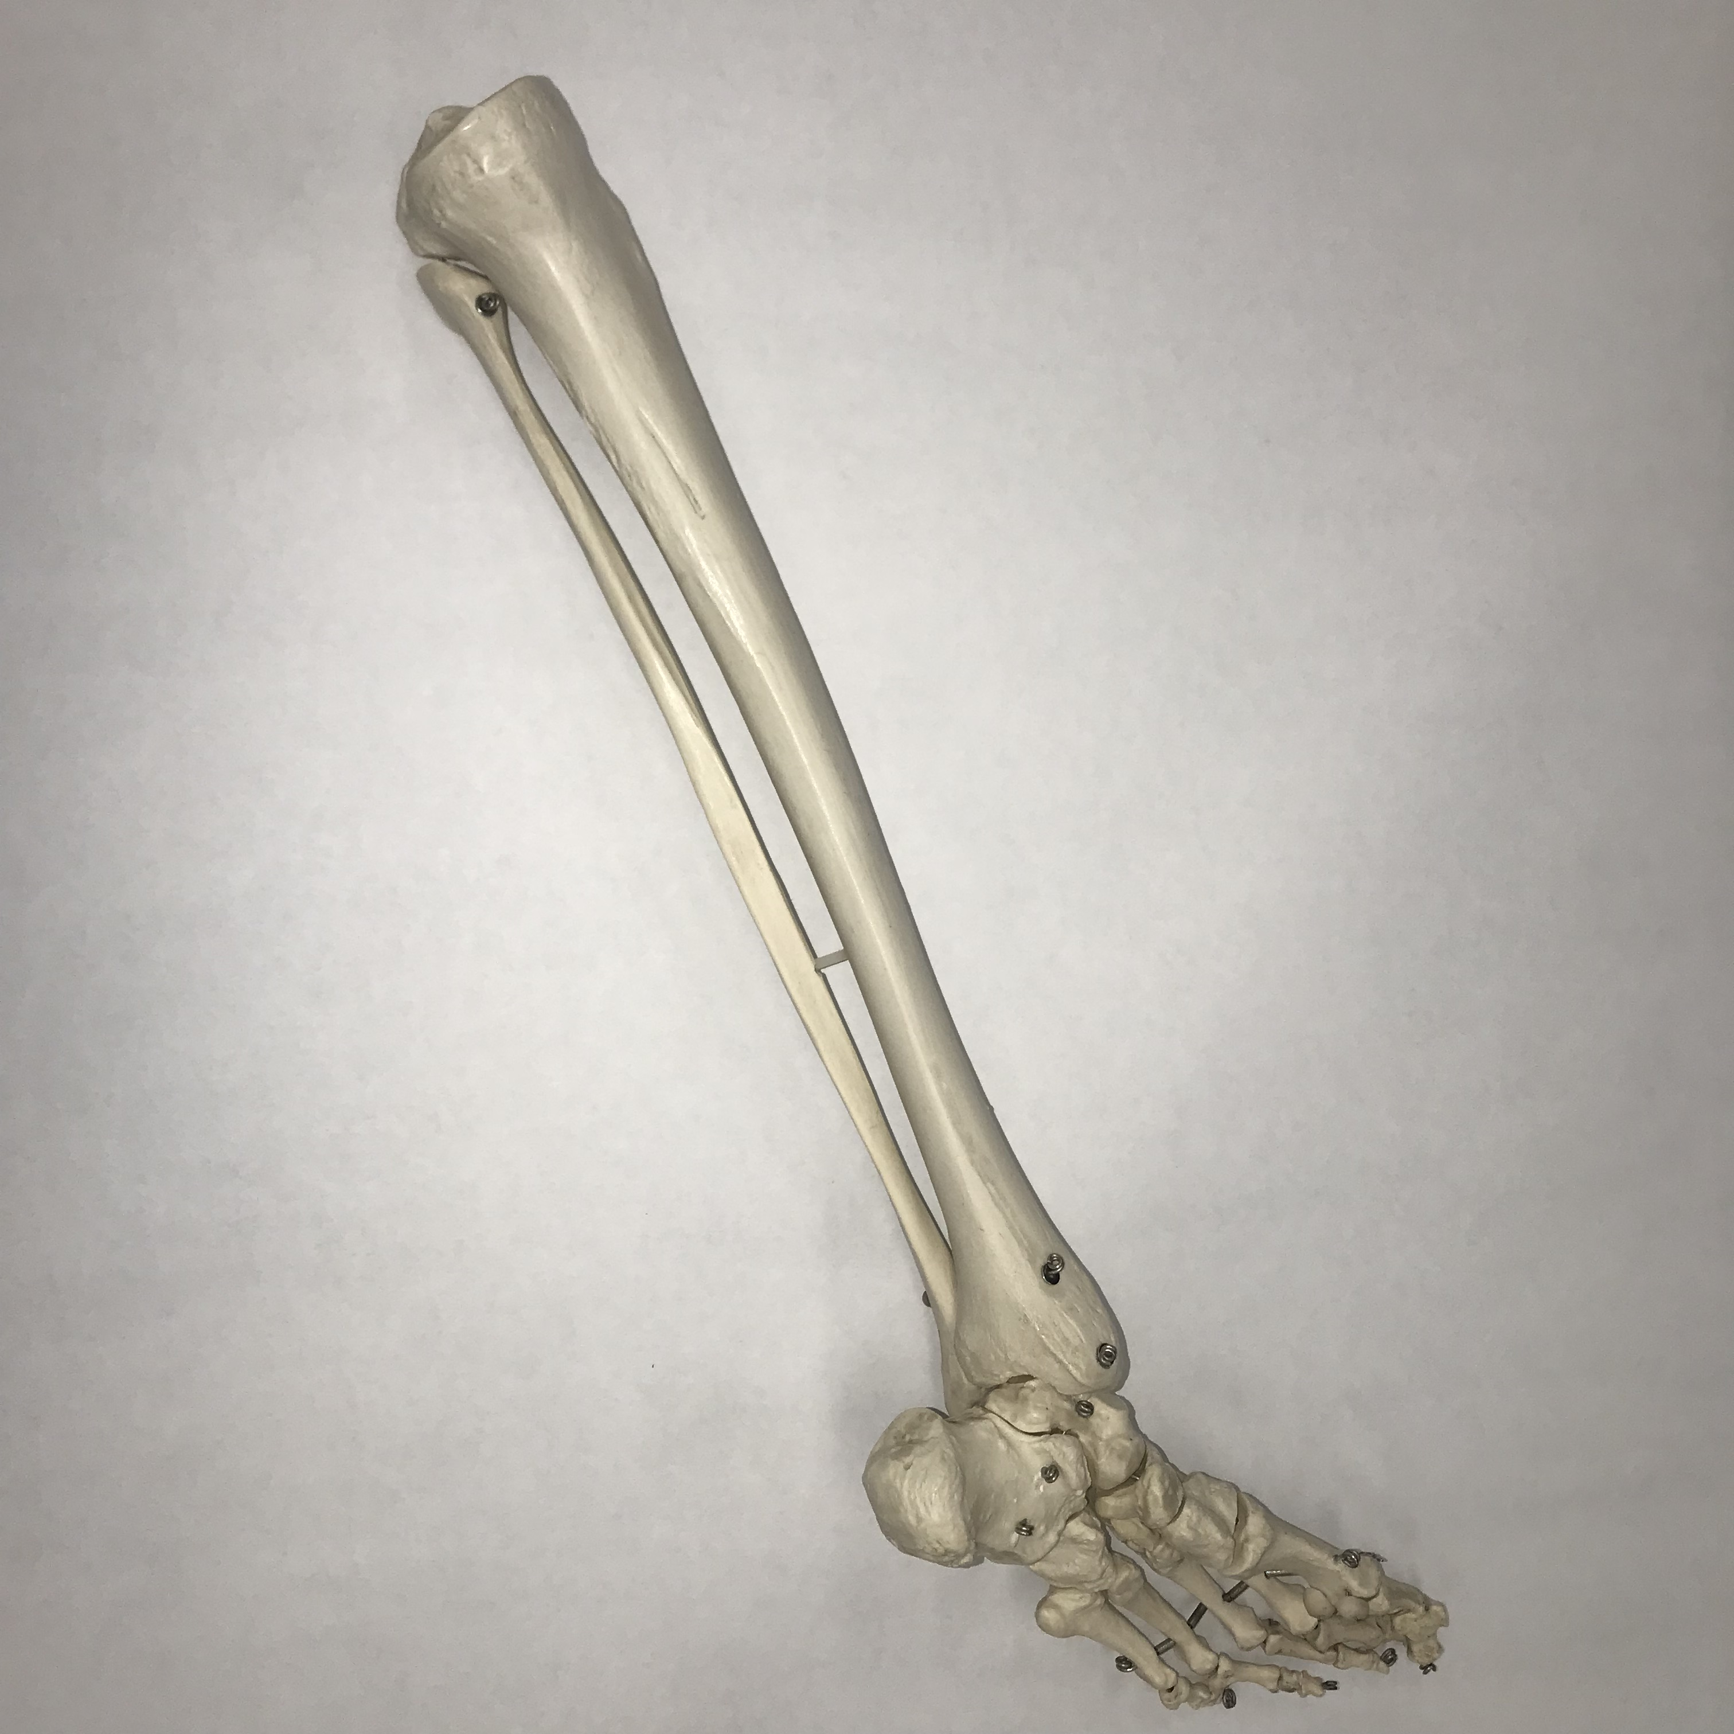
#4: Name this bone.

Slide 6
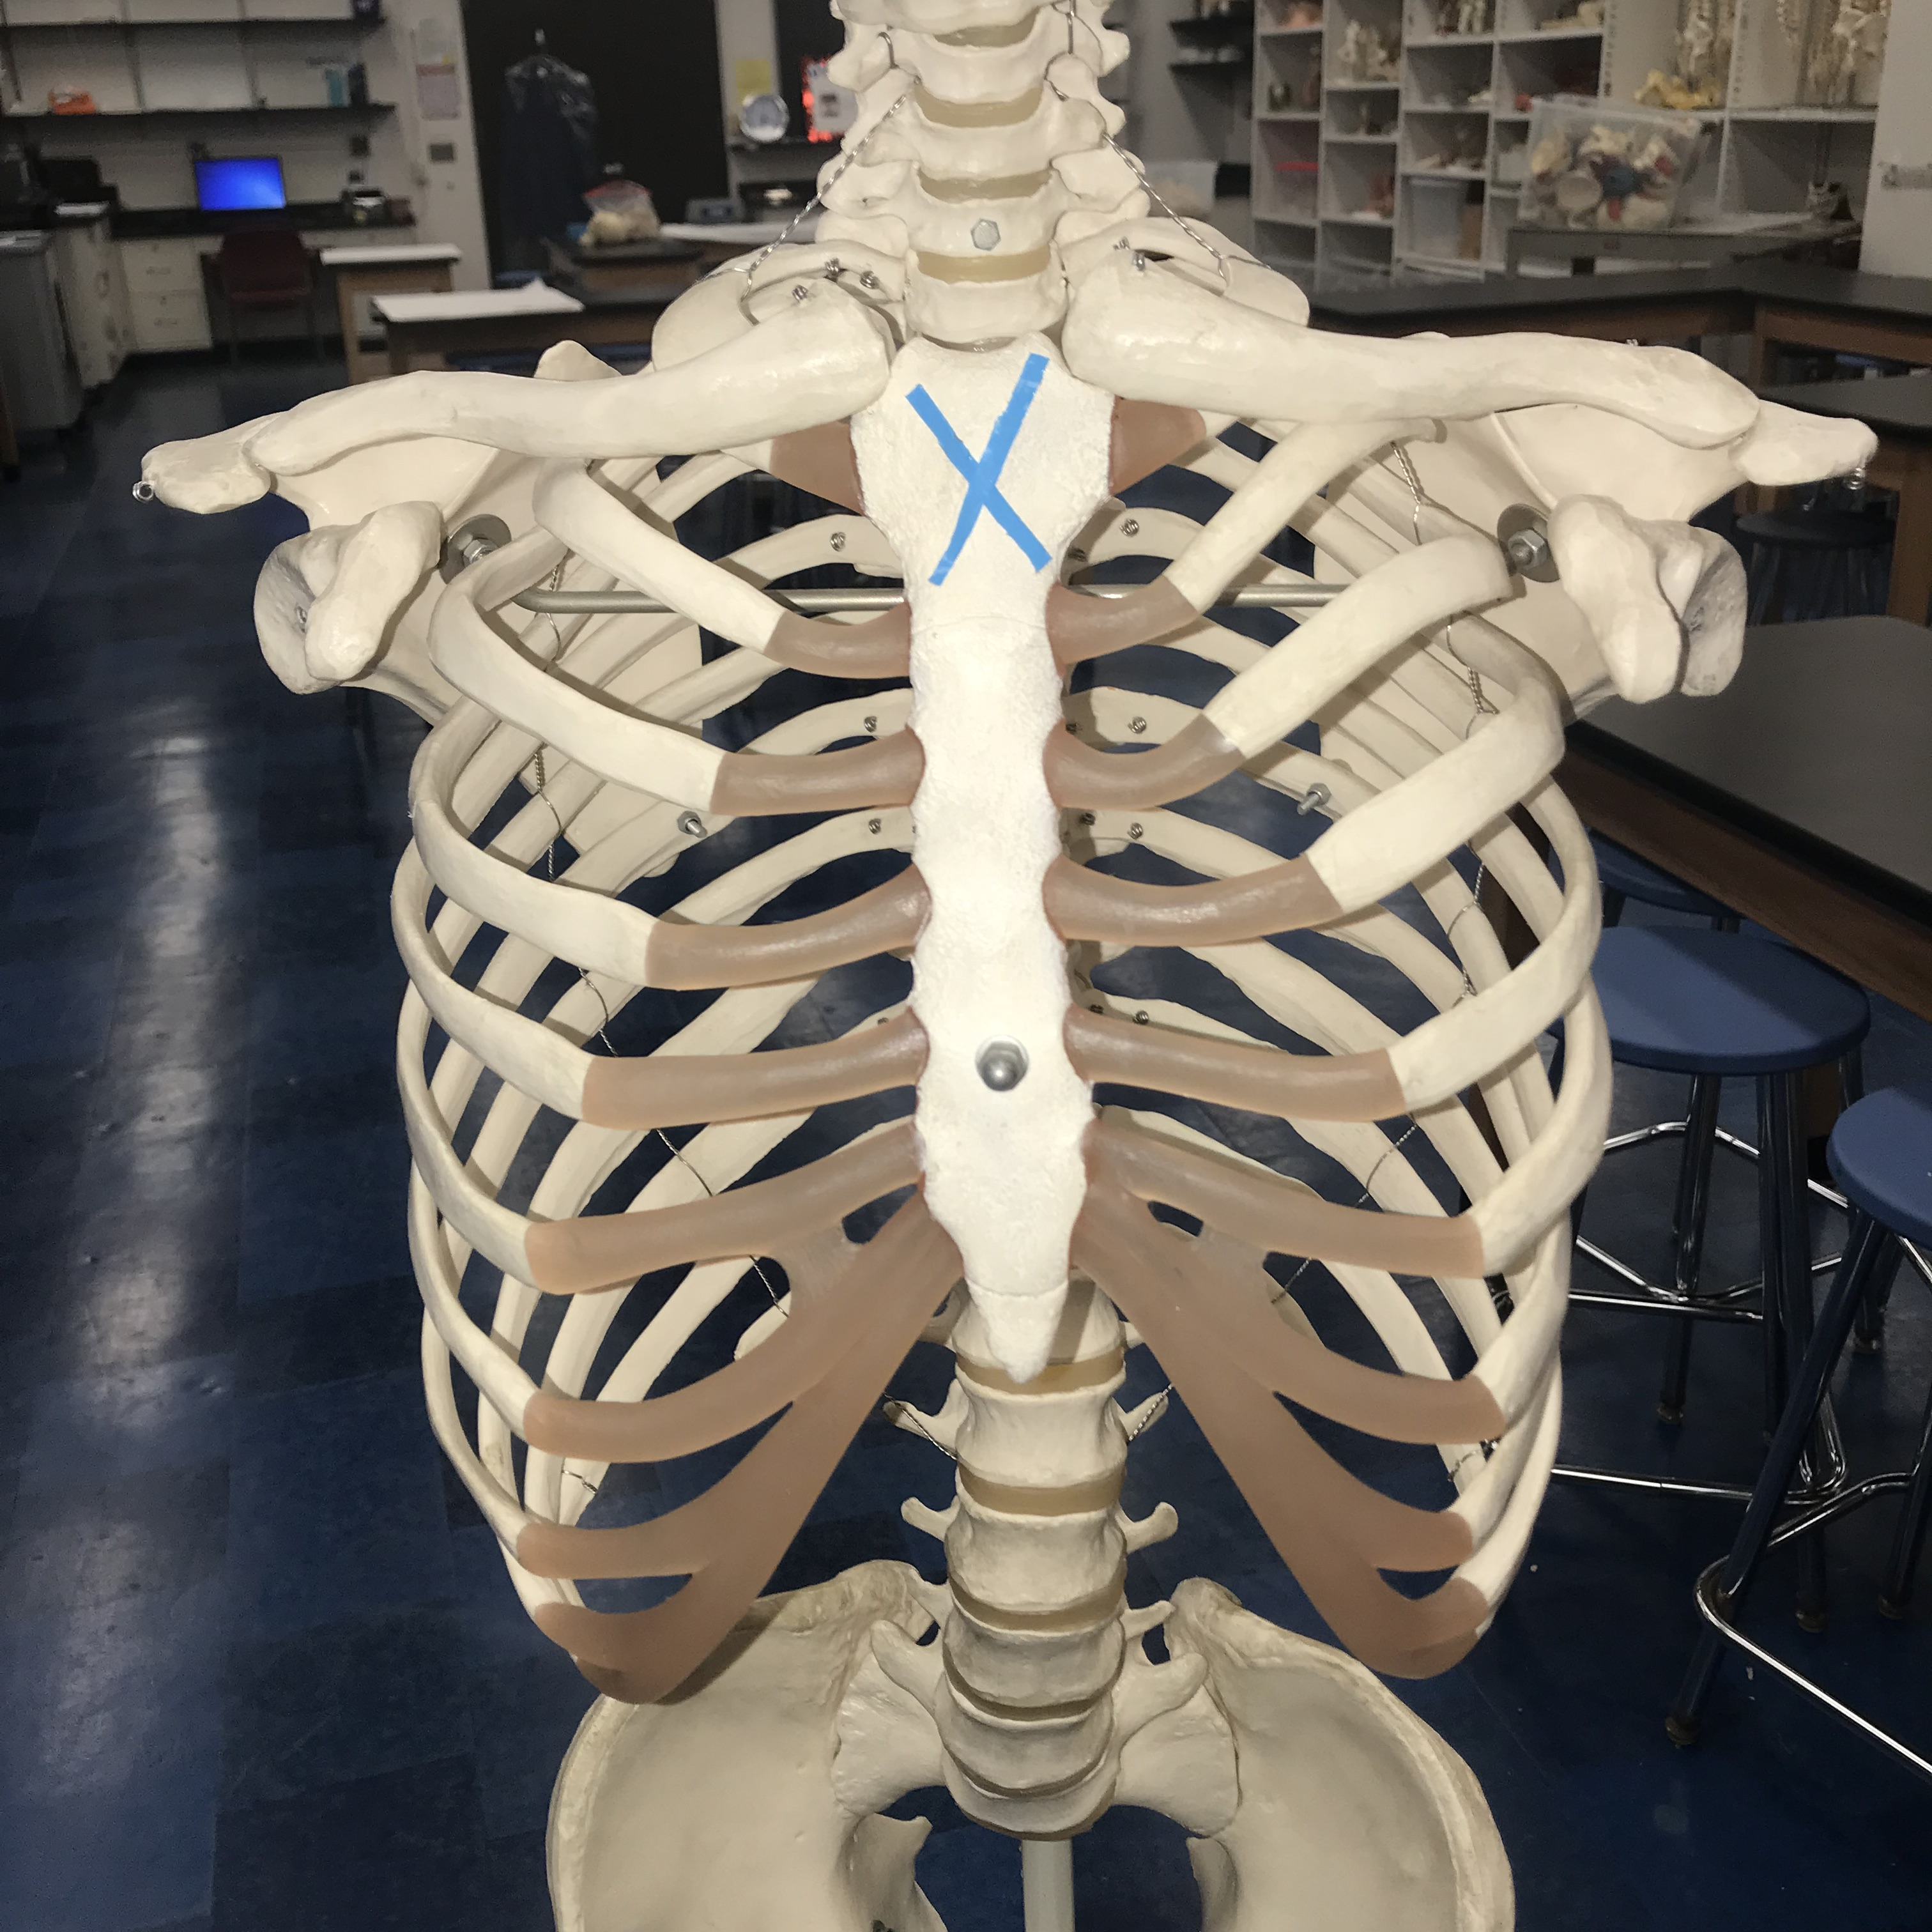
#5: Name this bony feature.

Slide 7
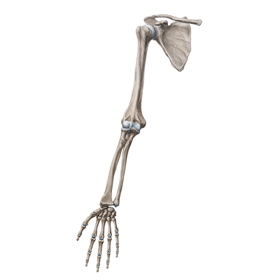
#6: The carpal bones are ________ to the ulna.

Slide 8
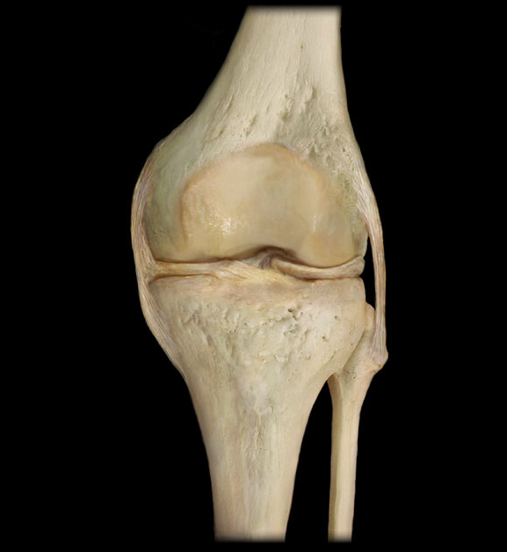
#7: Name this ligament.

Slide 9
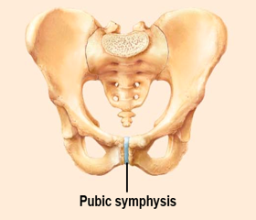
#8: Classify this joint based off of its function.

Slide 10
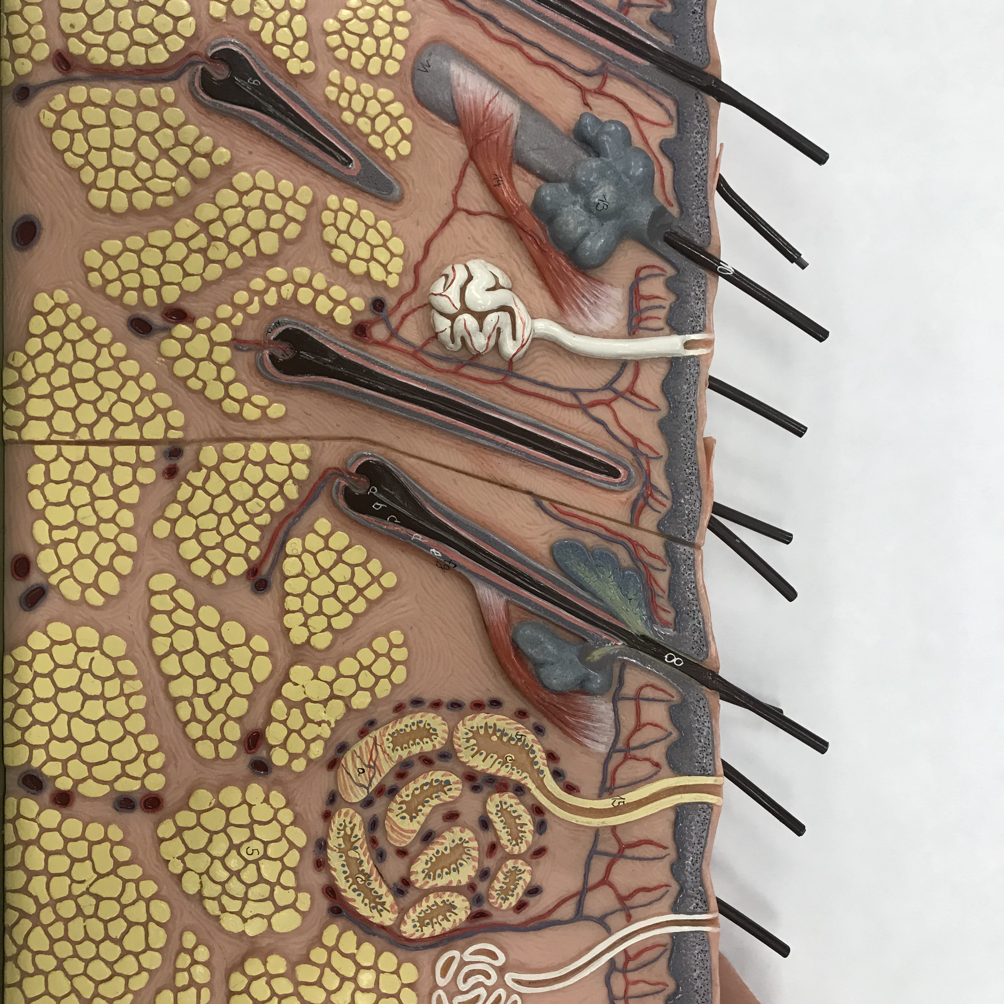
#9: Name this structure of the integument.

Slide 11
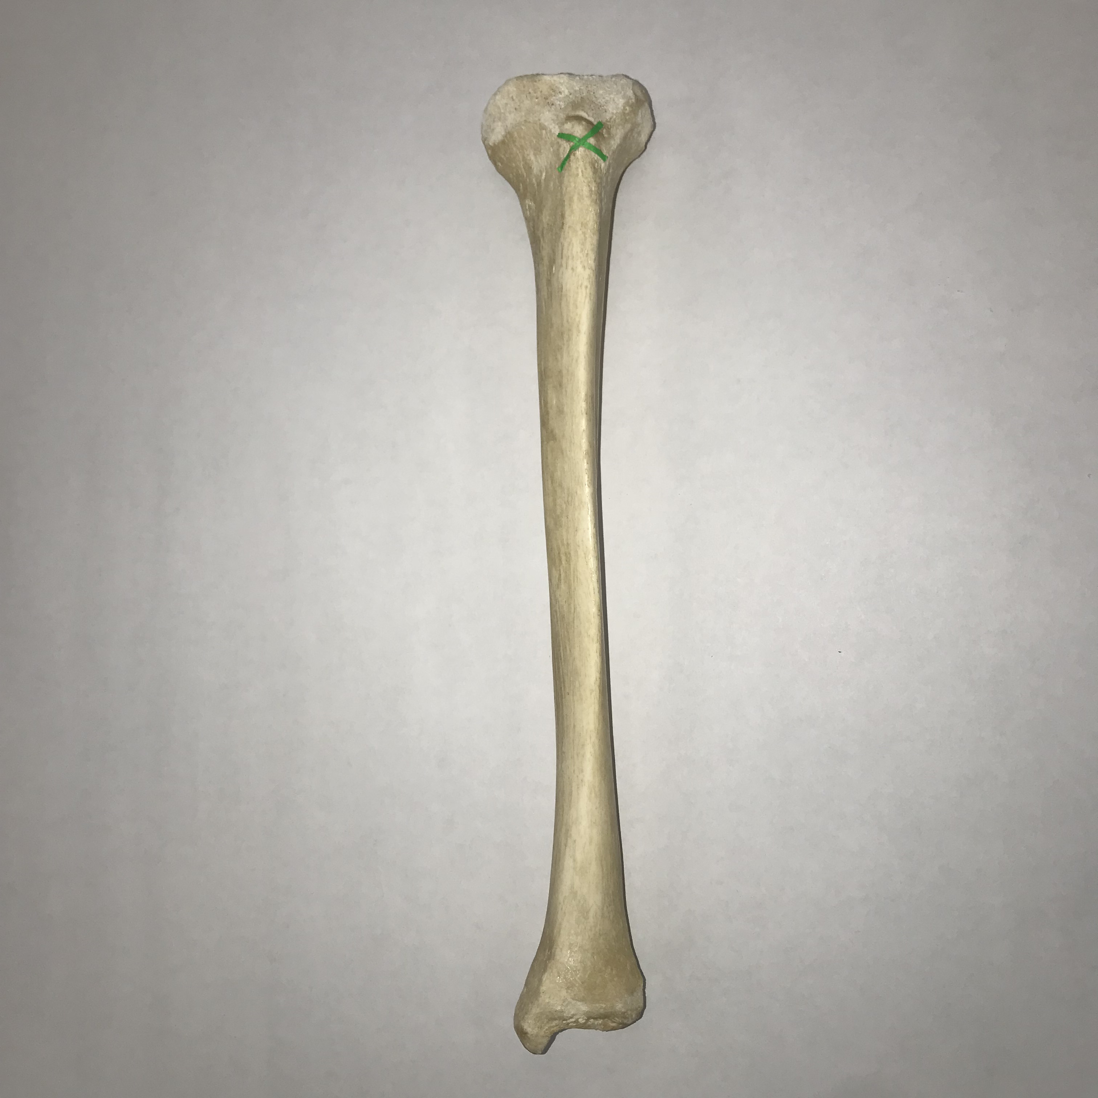
#10: Name this bony feature.

Slide 12
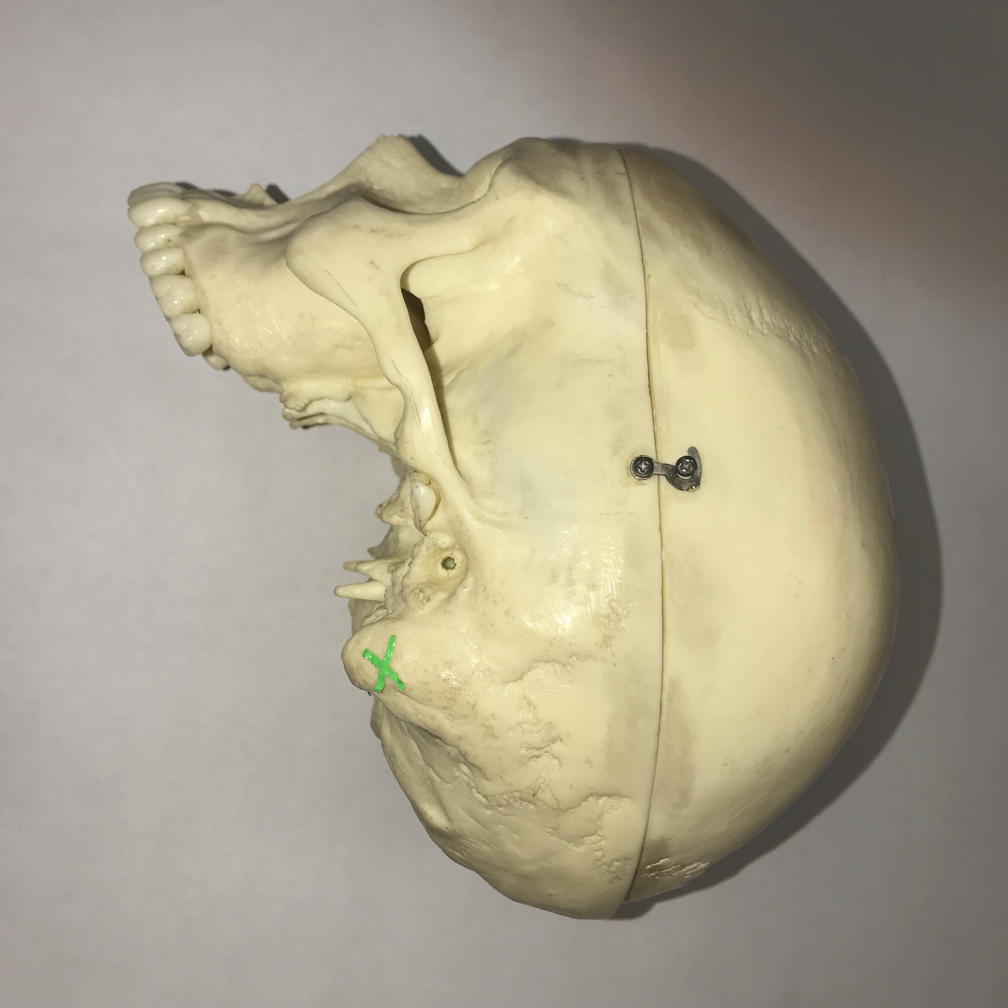
#11: Name this bony feature.

Slide 13
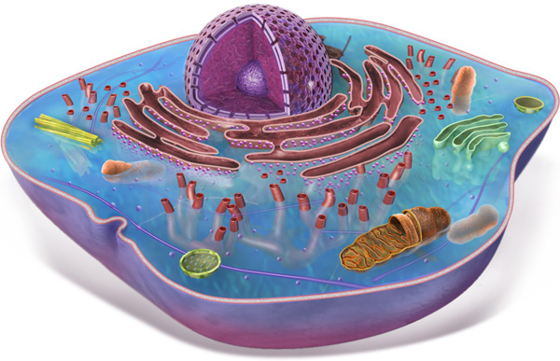
#12: Name one basic function of the labeled structure.

Slide 14
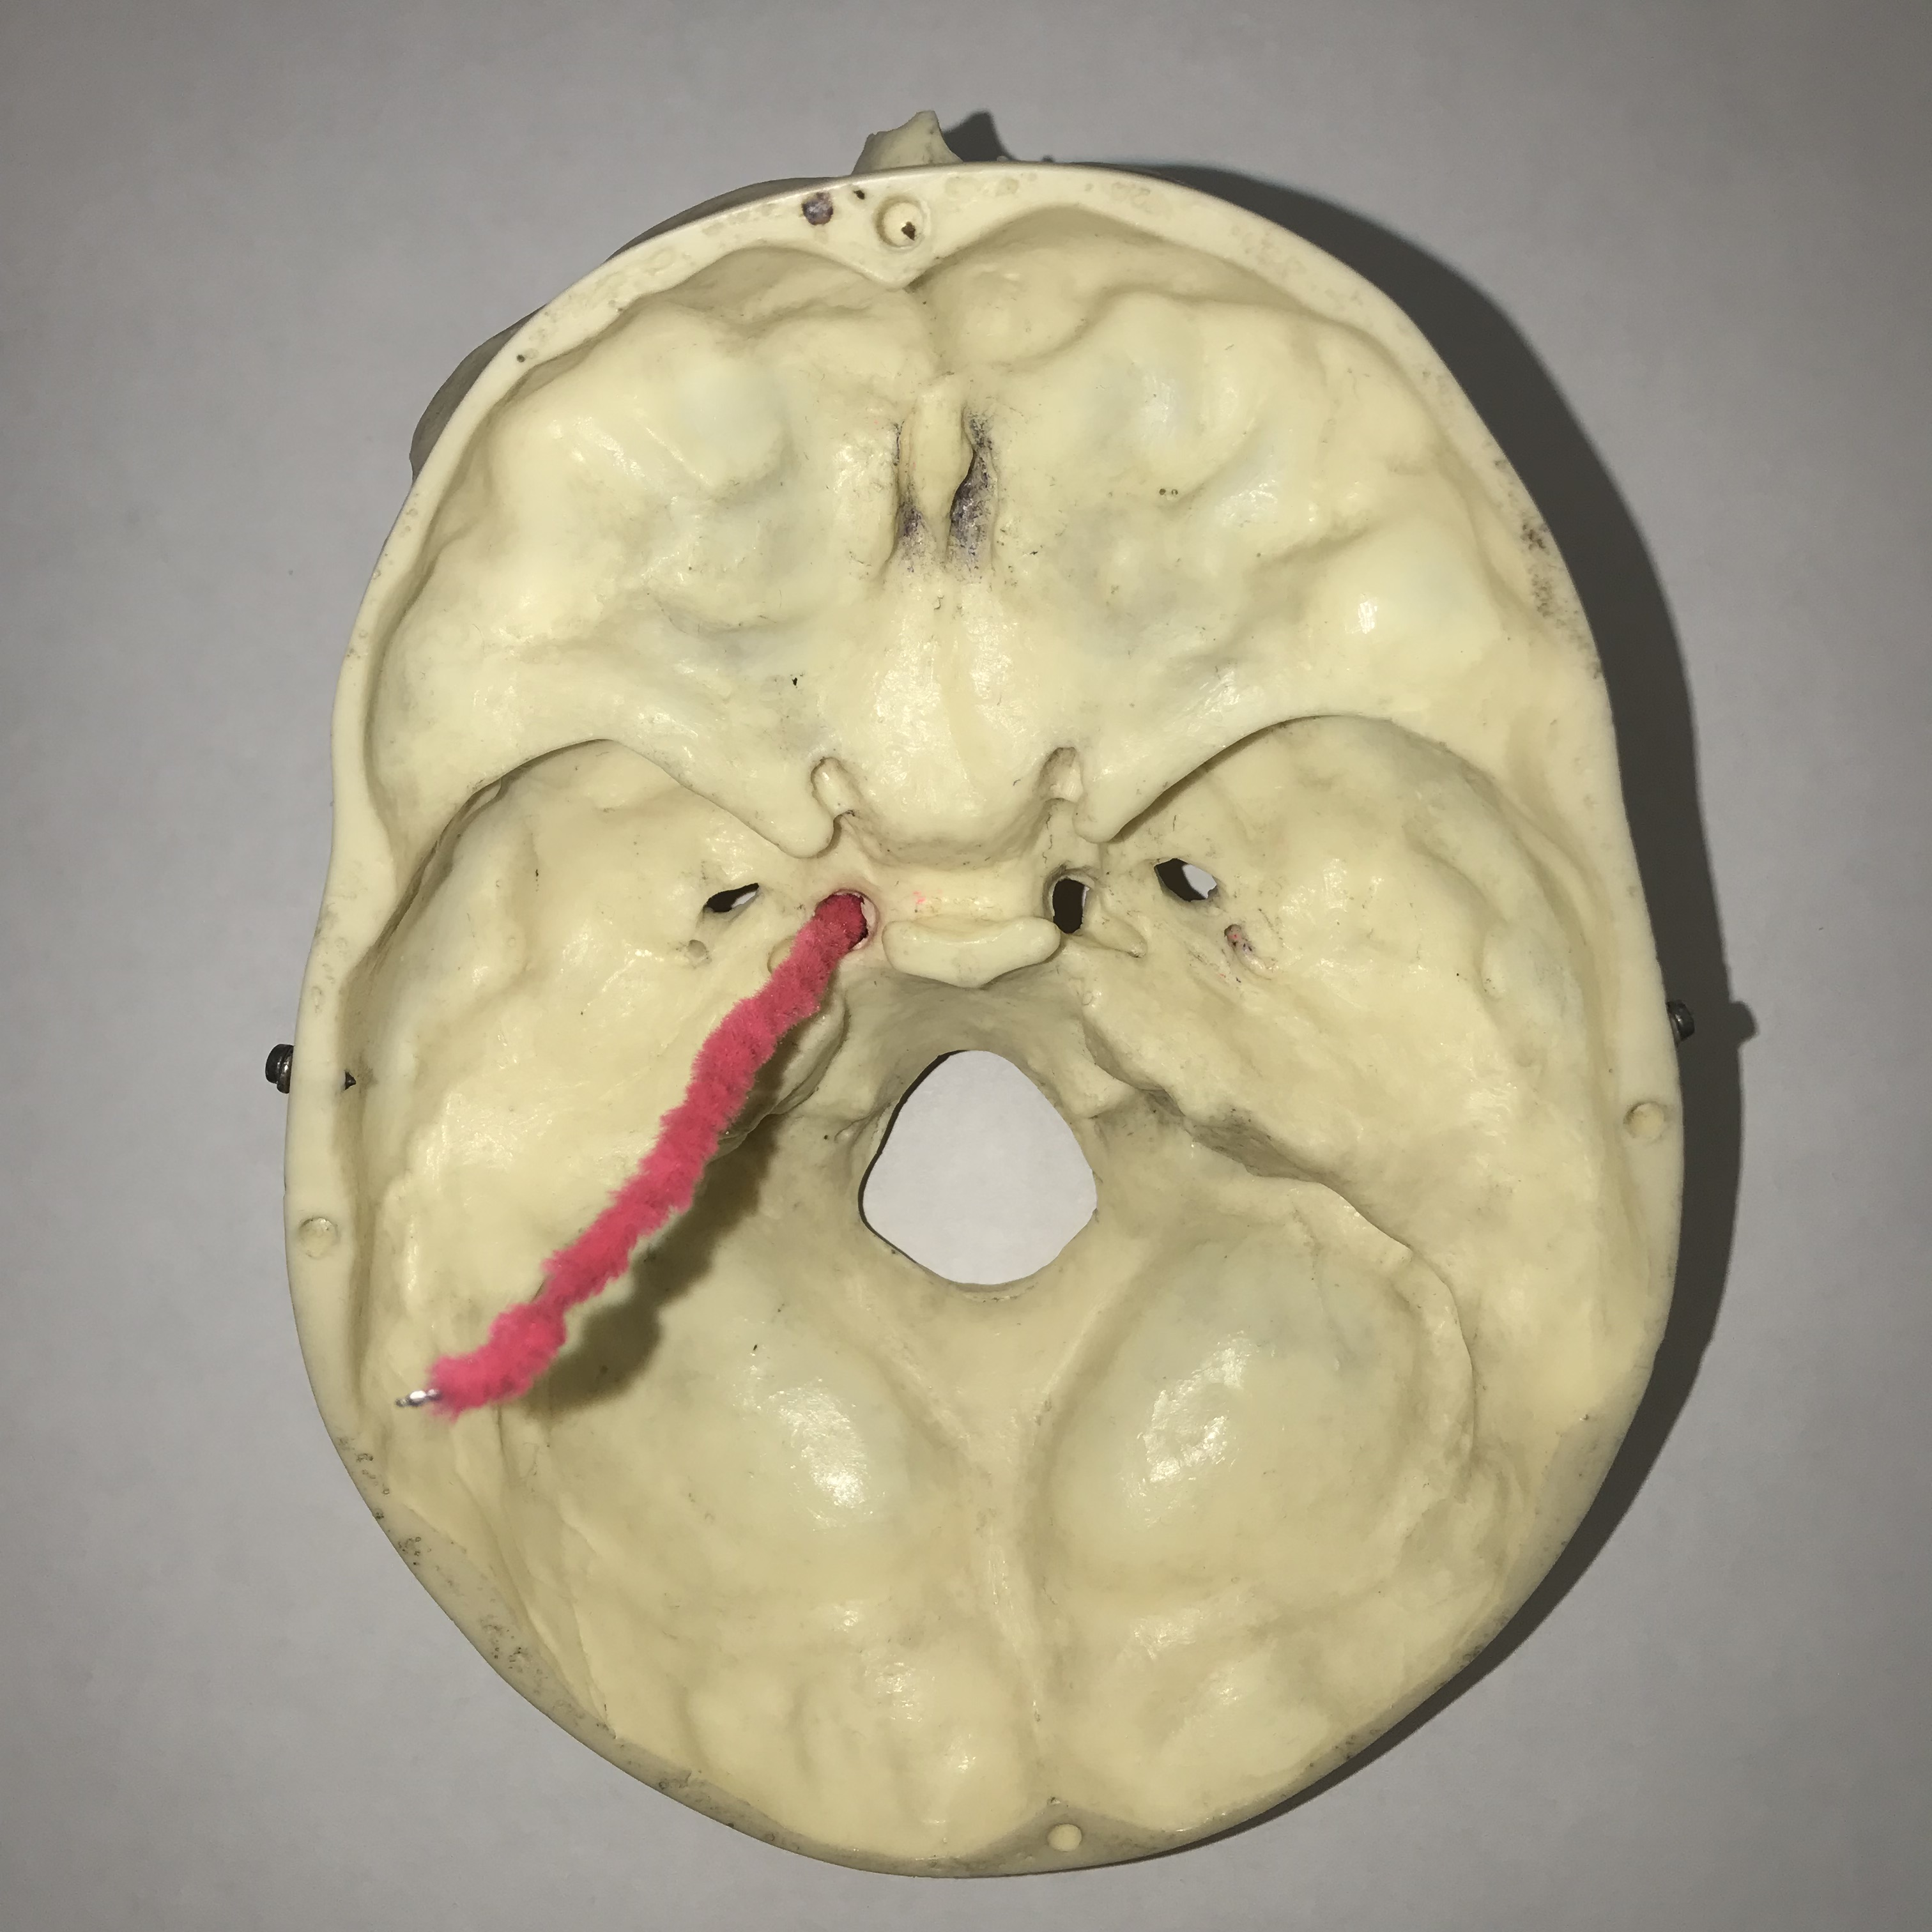
#13: Name this space.

Slide 15
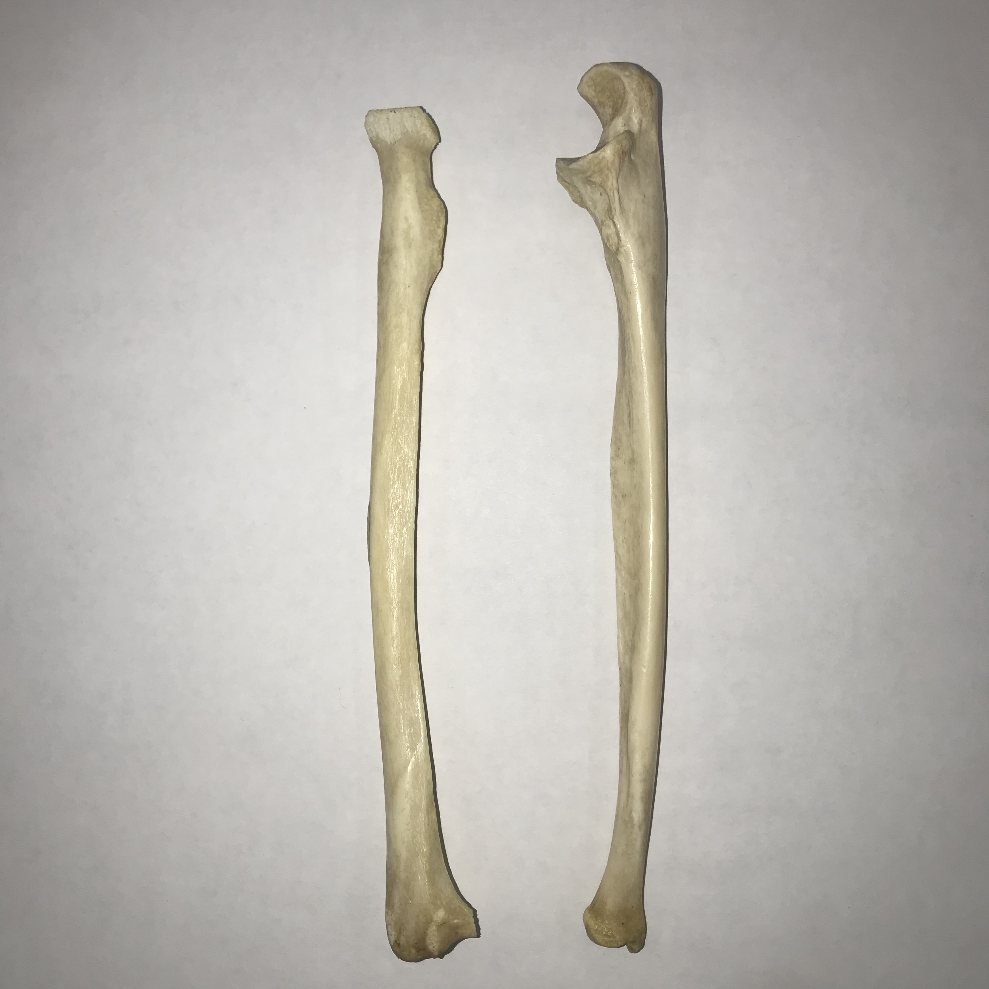
#14: Identify the ulna bone. (A or B)
A B

Slide 16
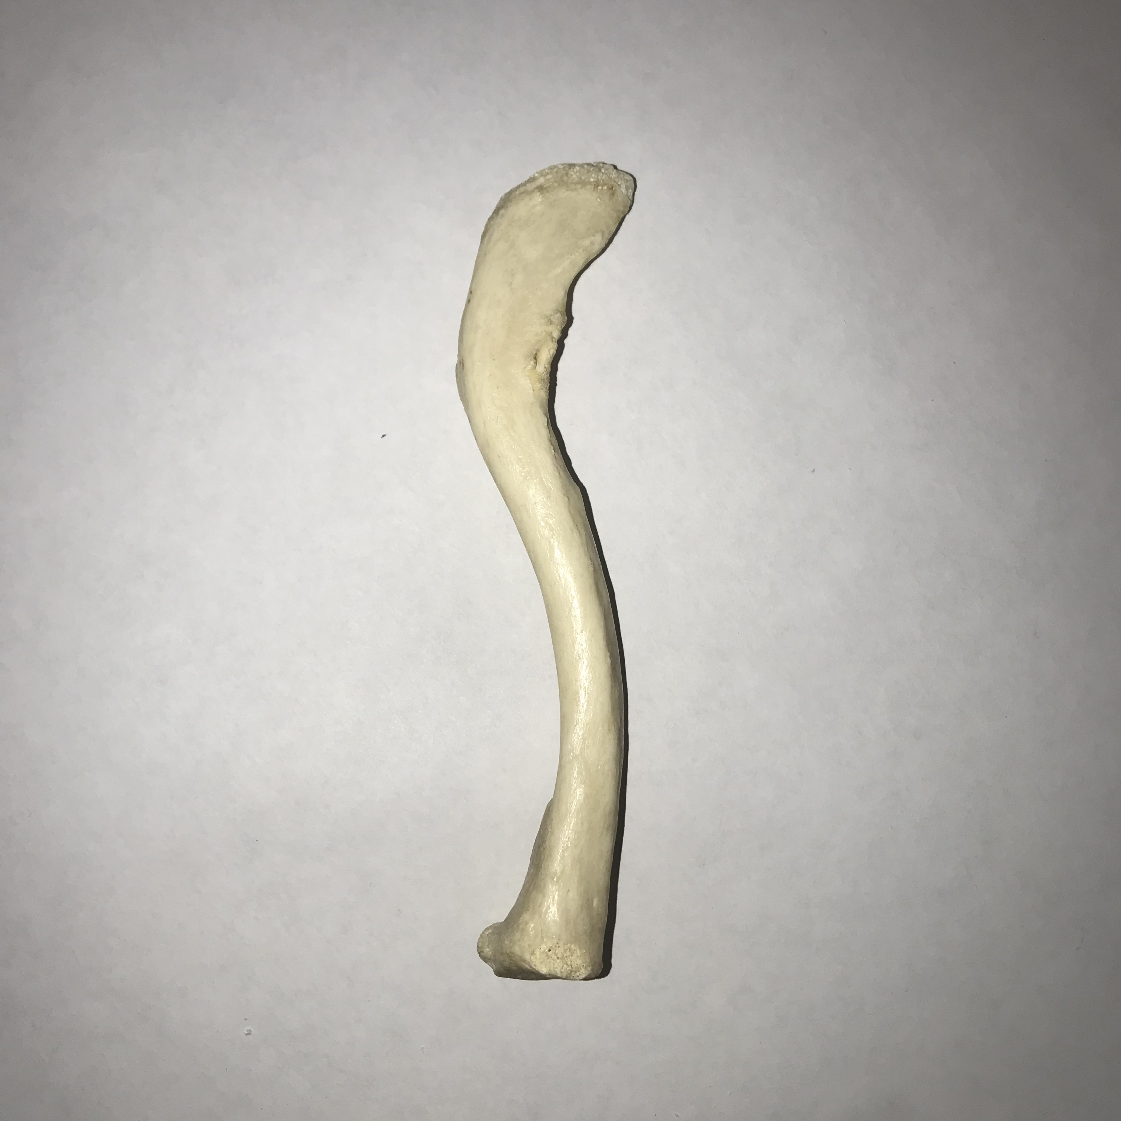
#15: Identify the sternal end of the clavicle (A or B).
A
B

Slide 17

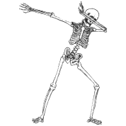
#16: Name one bone in the body that has a coronoid process.

Slide 18
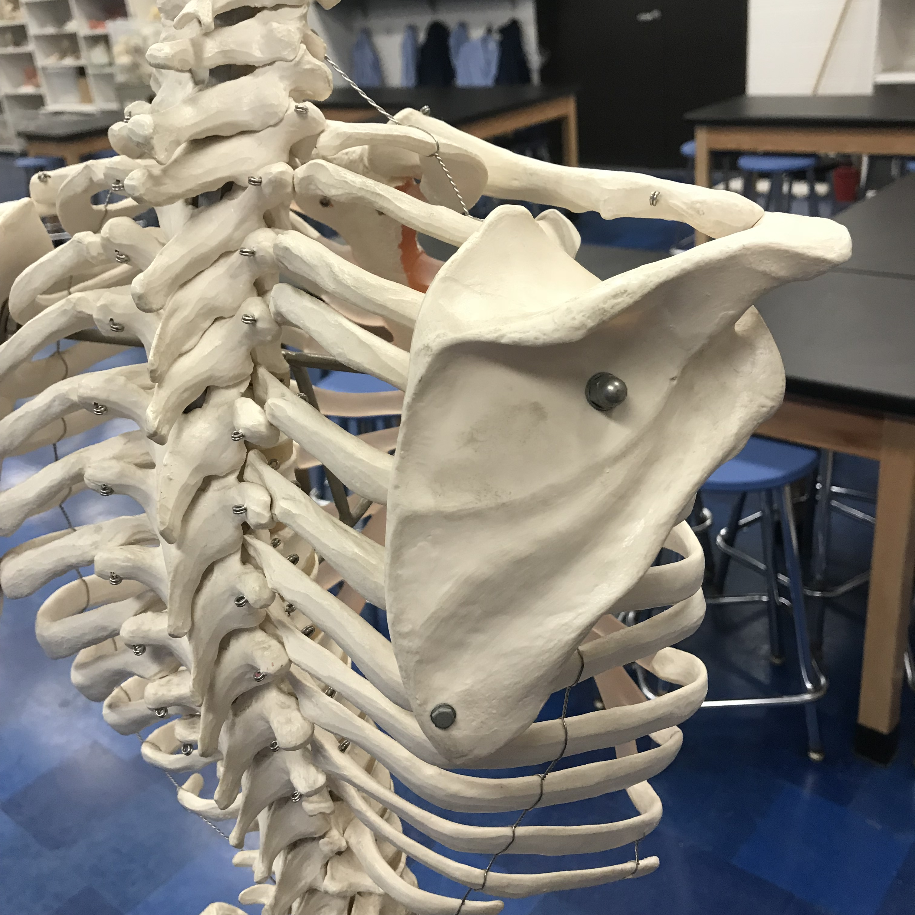
#17: Name this region.

Slide 19
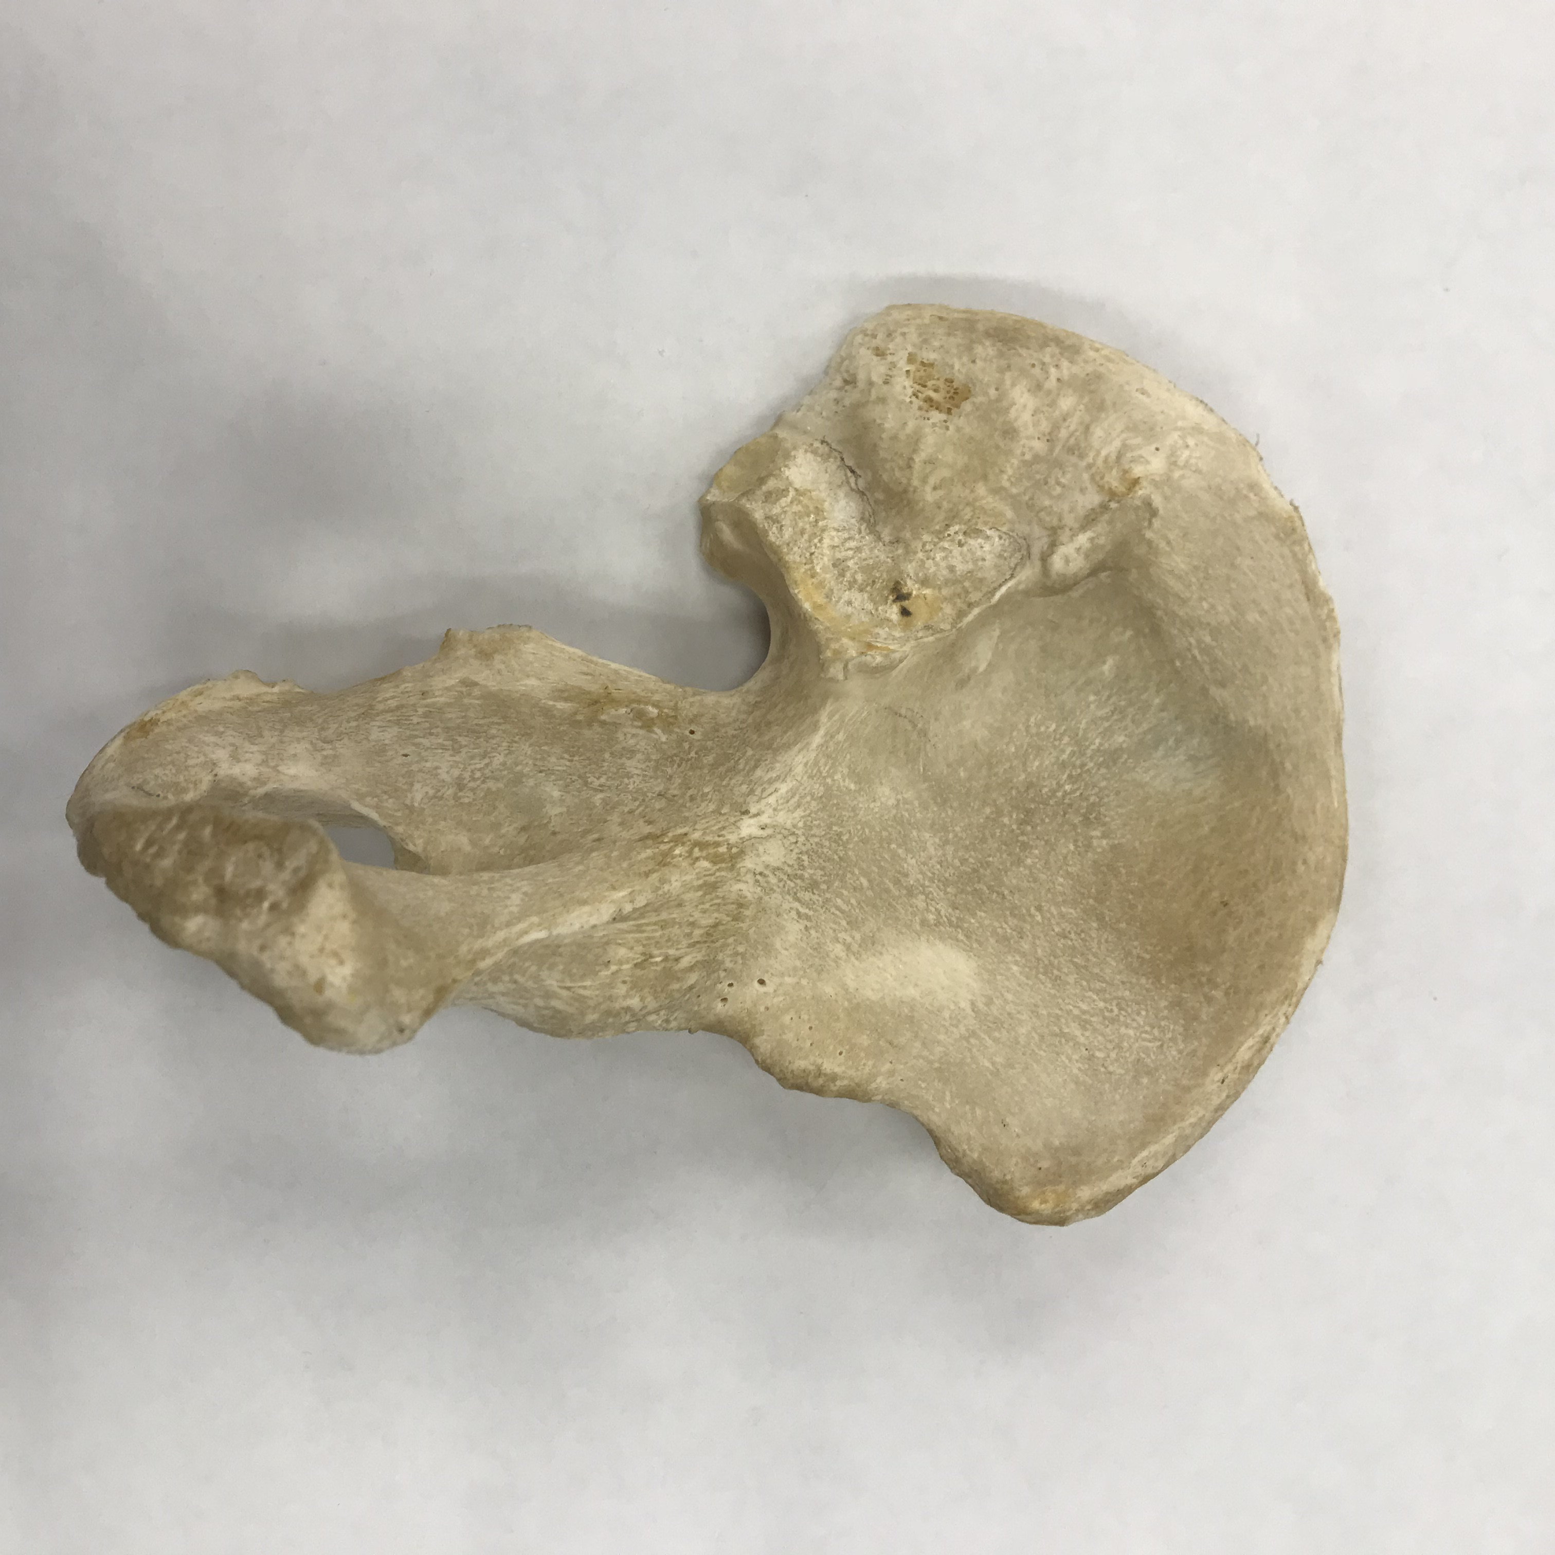
#18: Name this bony process.

Slide 20
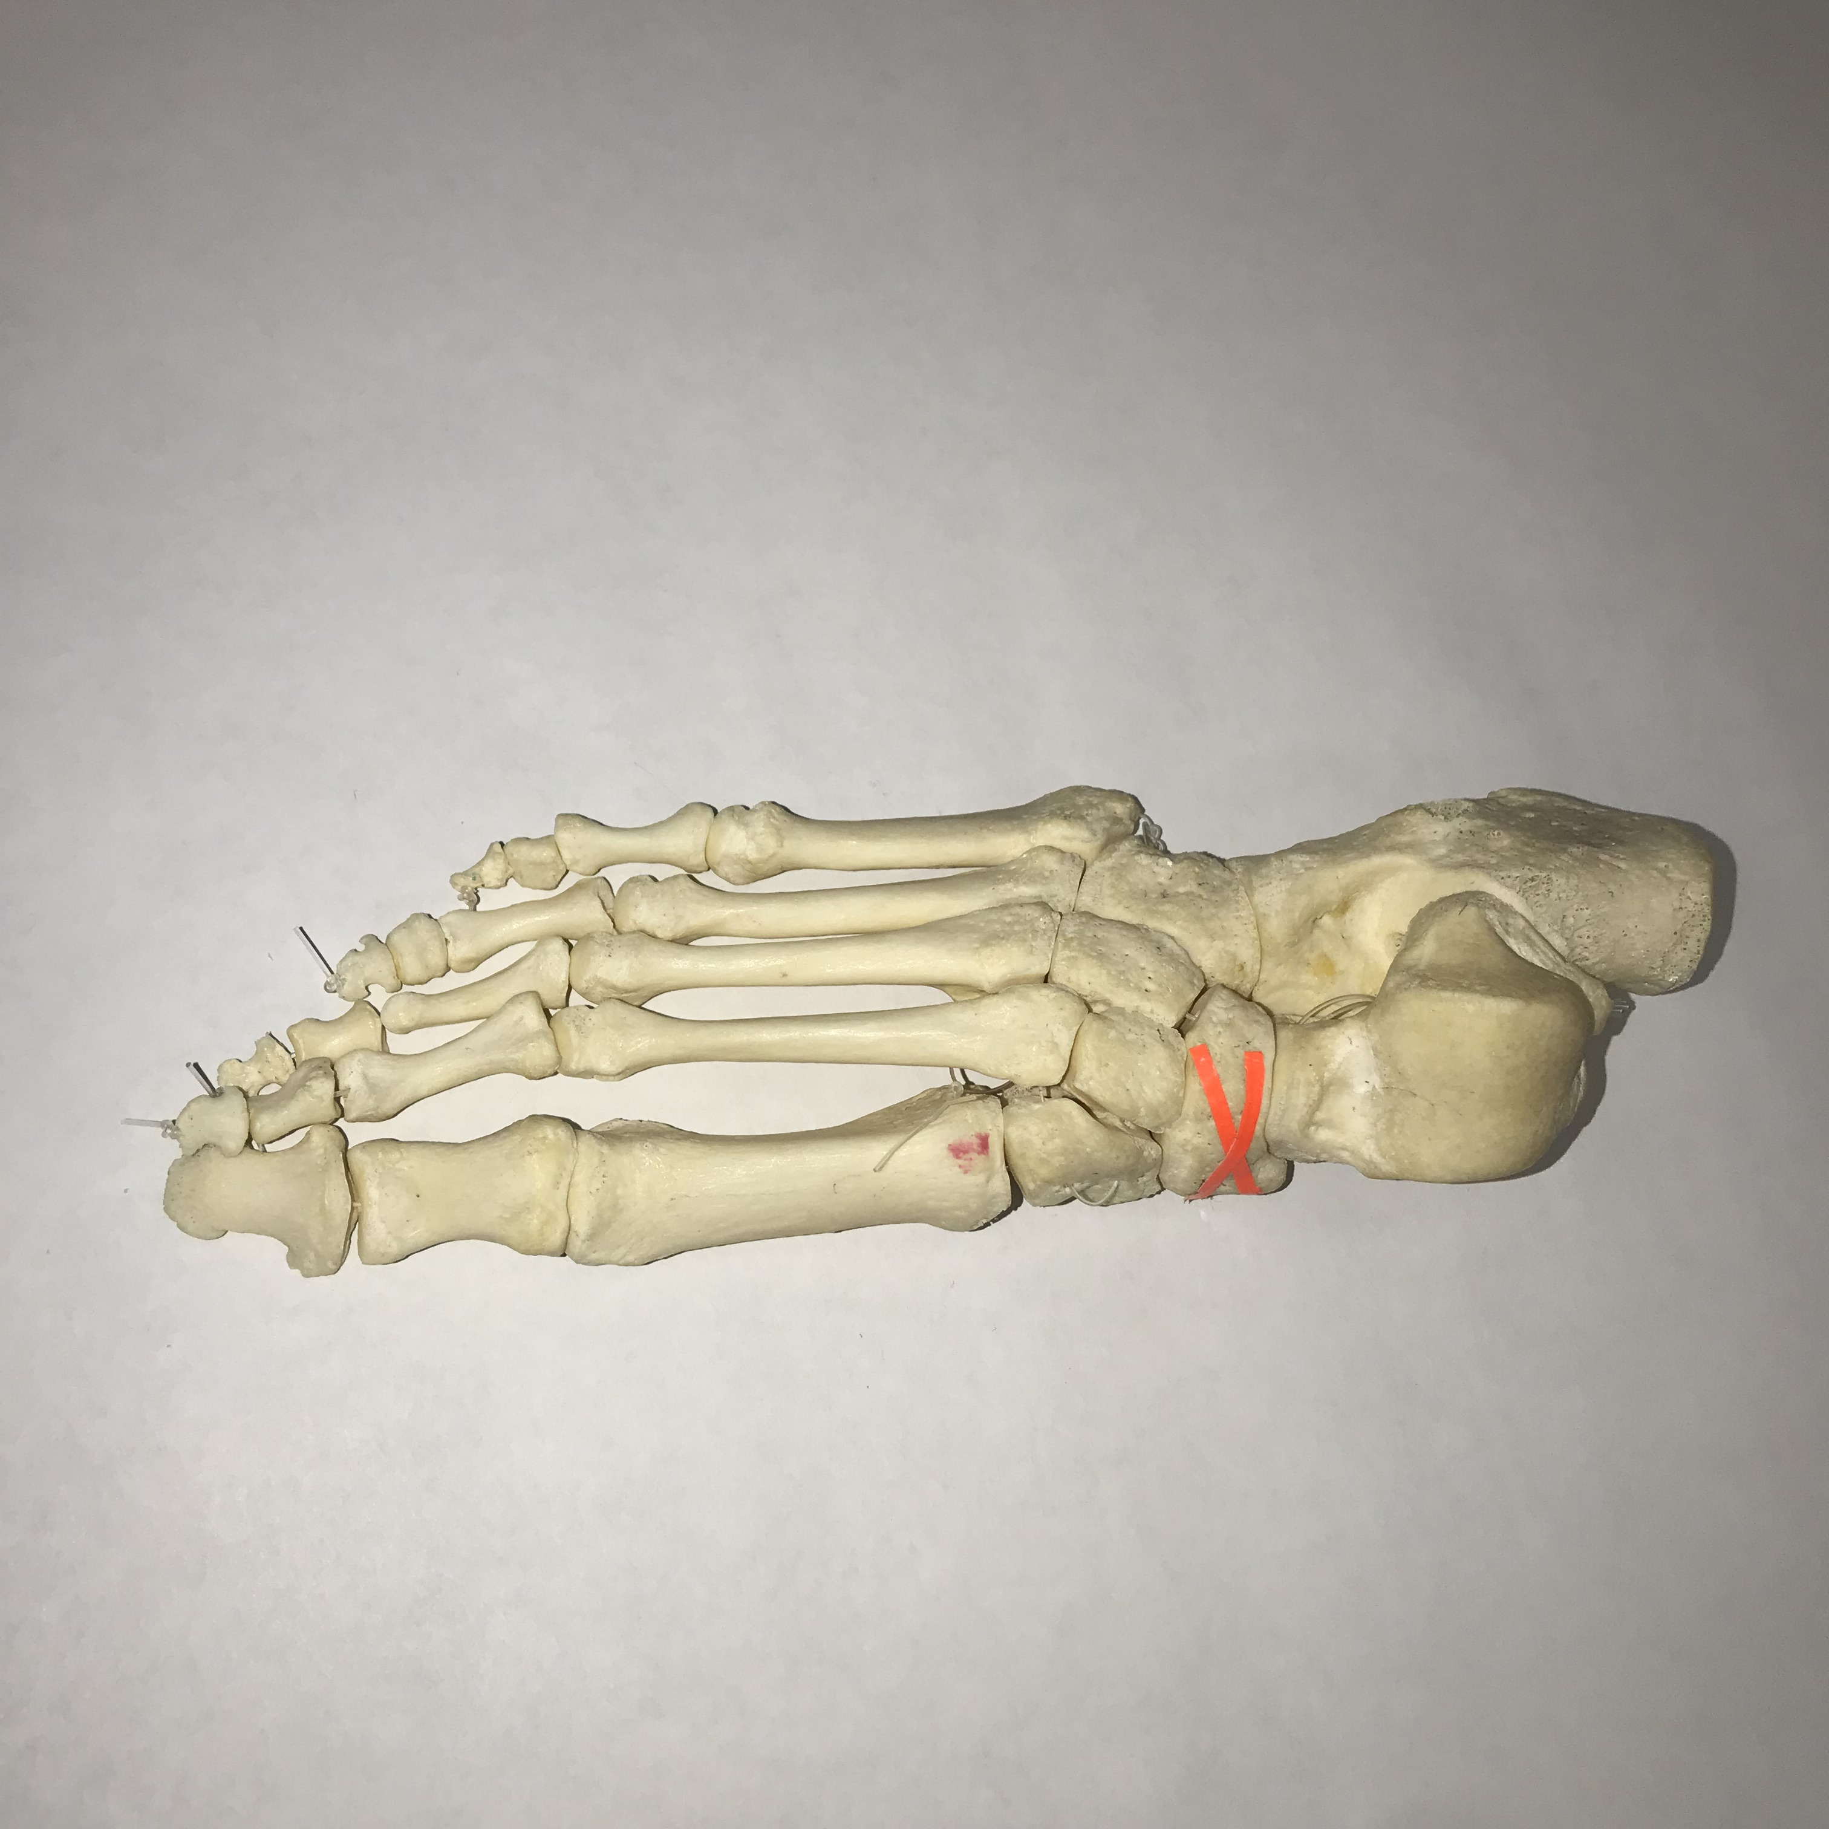
#19: Name this bone.

Slide 21
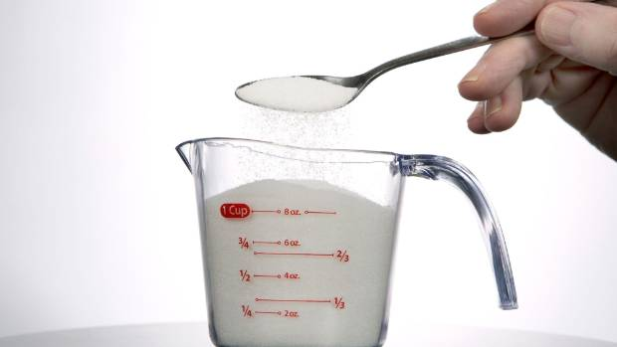
#20: A mystery solute is found in a jar. When placed into a cup of water, the solute dissolves entirely. What is the solute & what kind of bonds may hold this solute together?

Slide 22
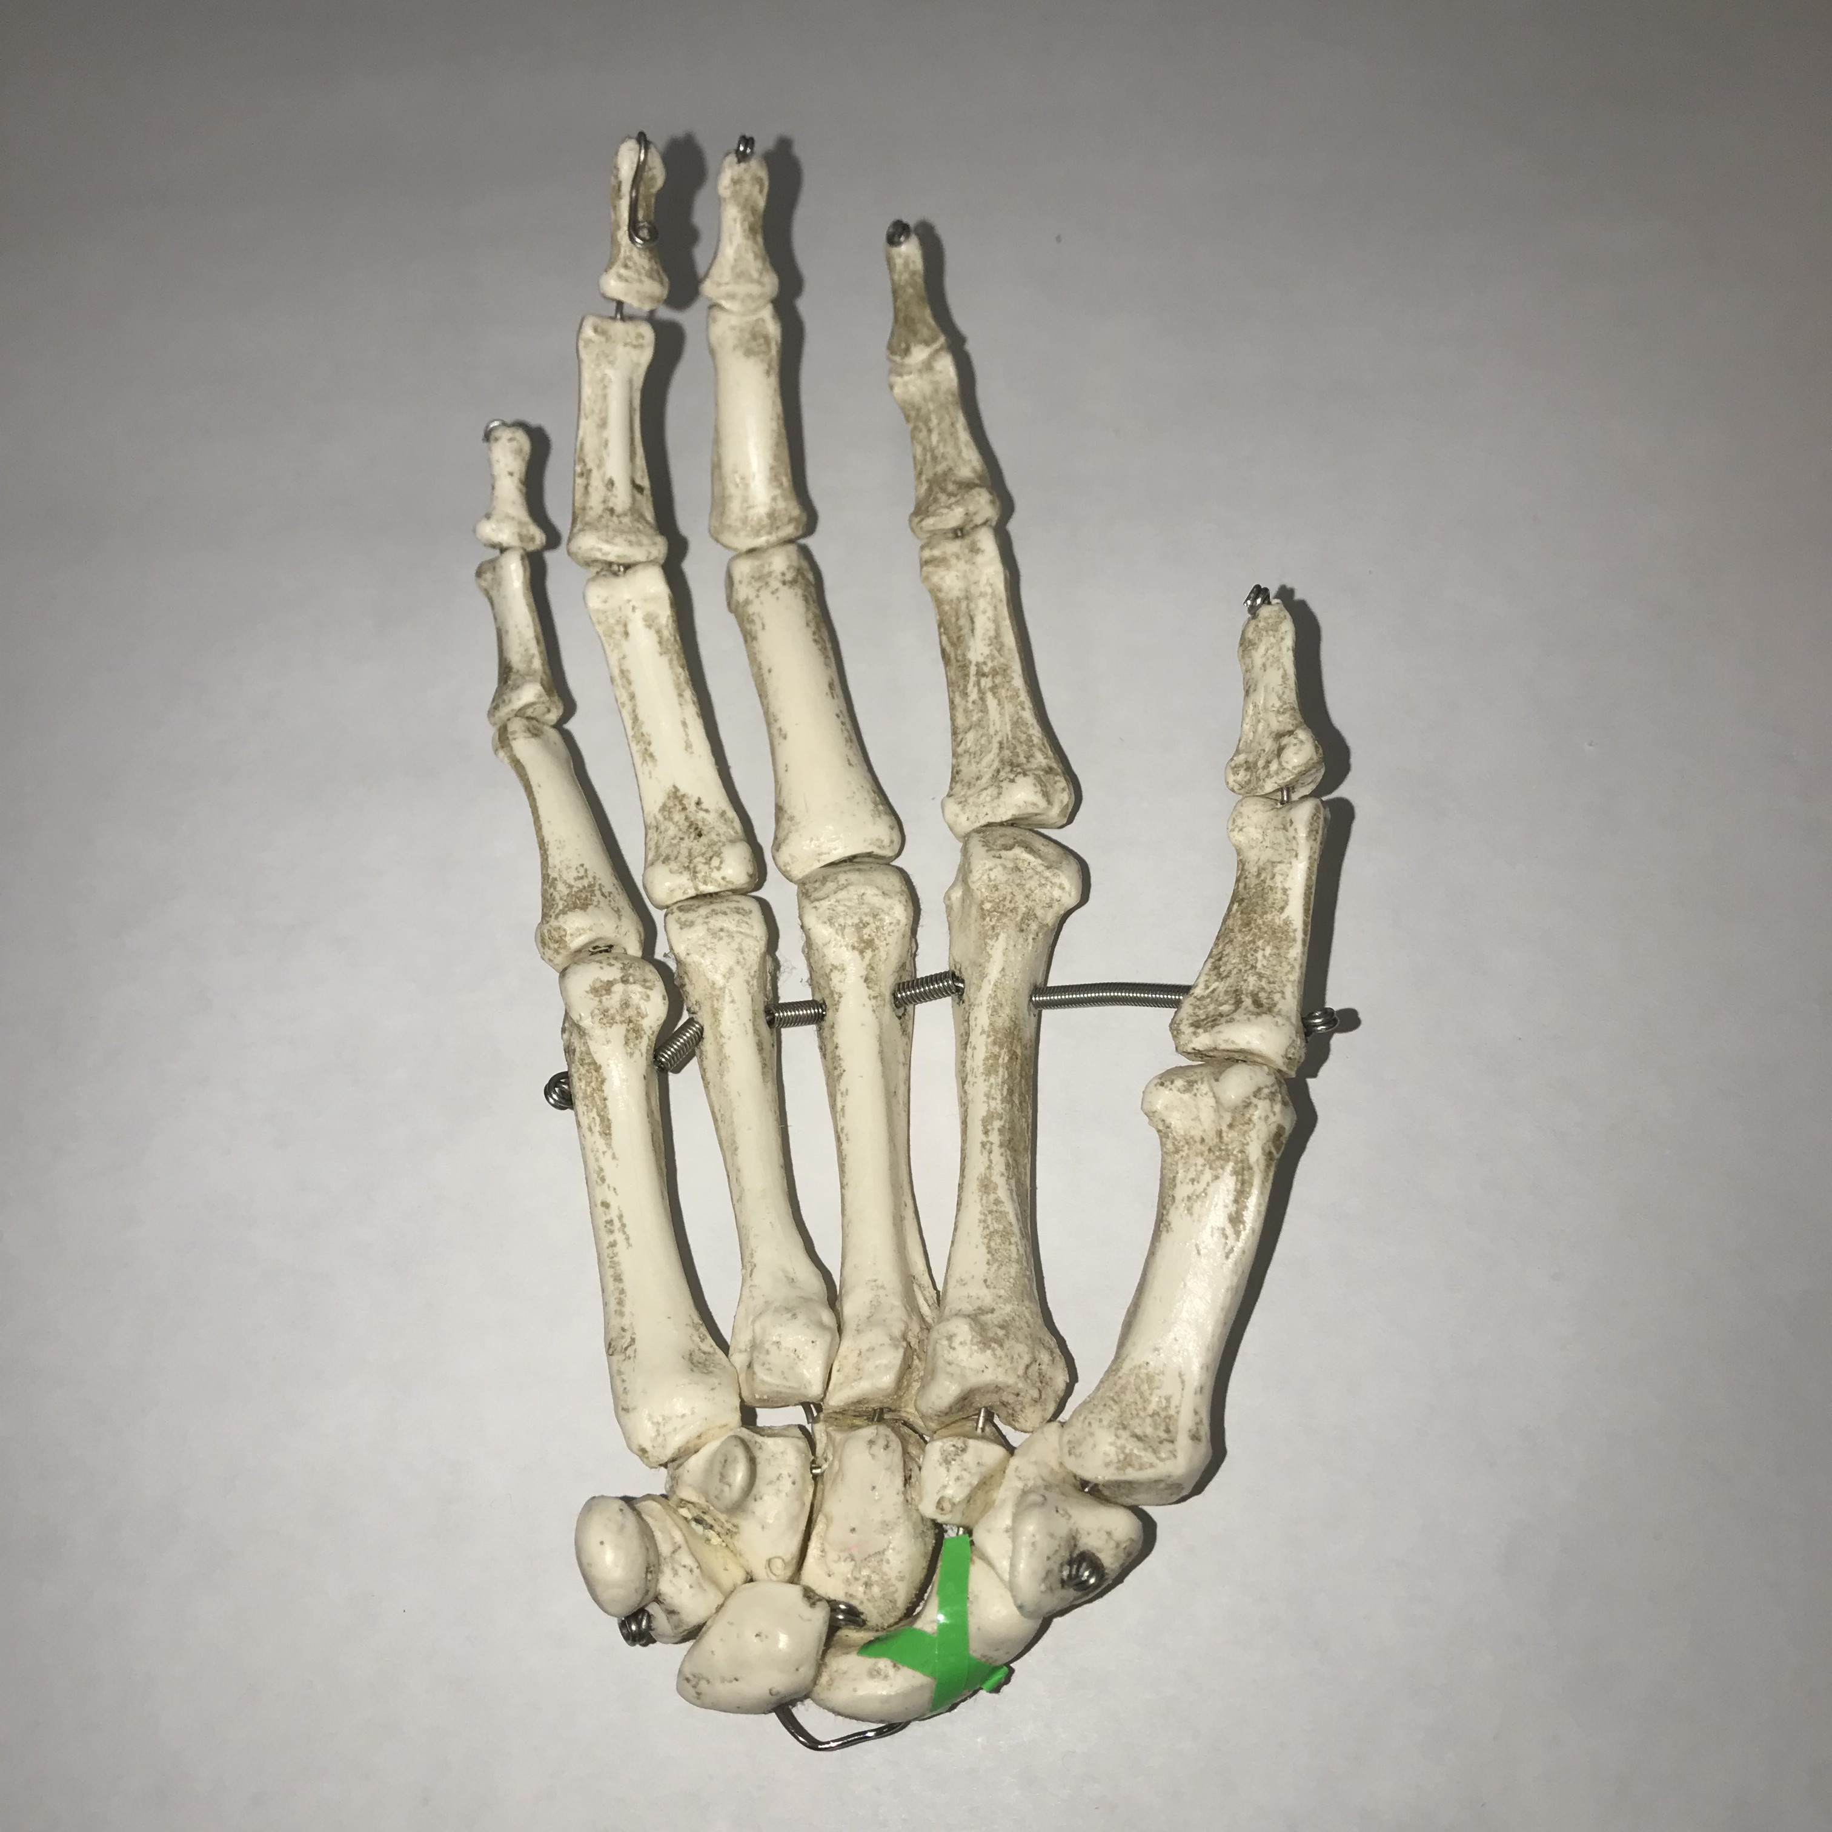
#21: Name this bone.

Slide 23
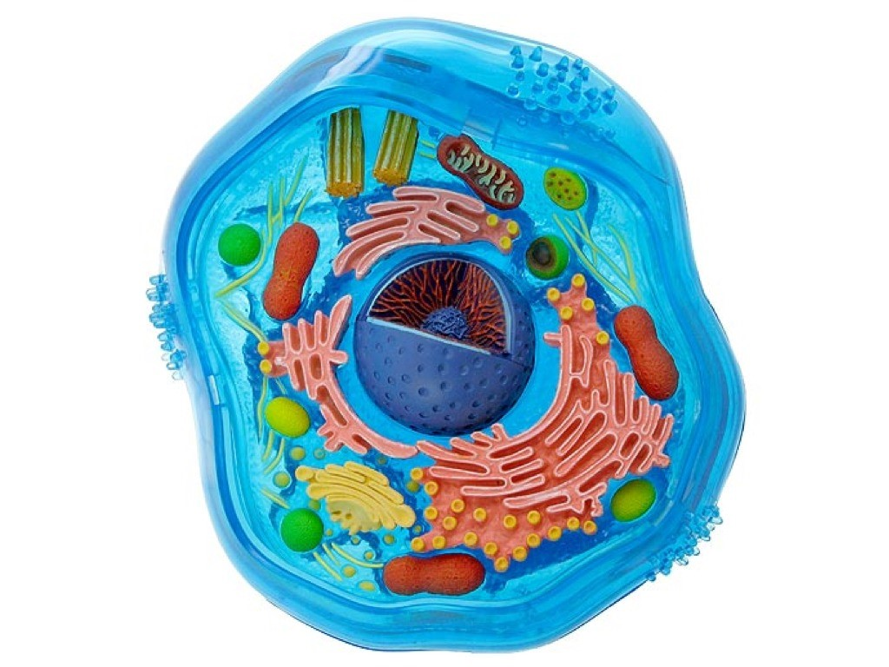
#22: Name one ion that is in higher concentration outside of the cell.

Slide 24
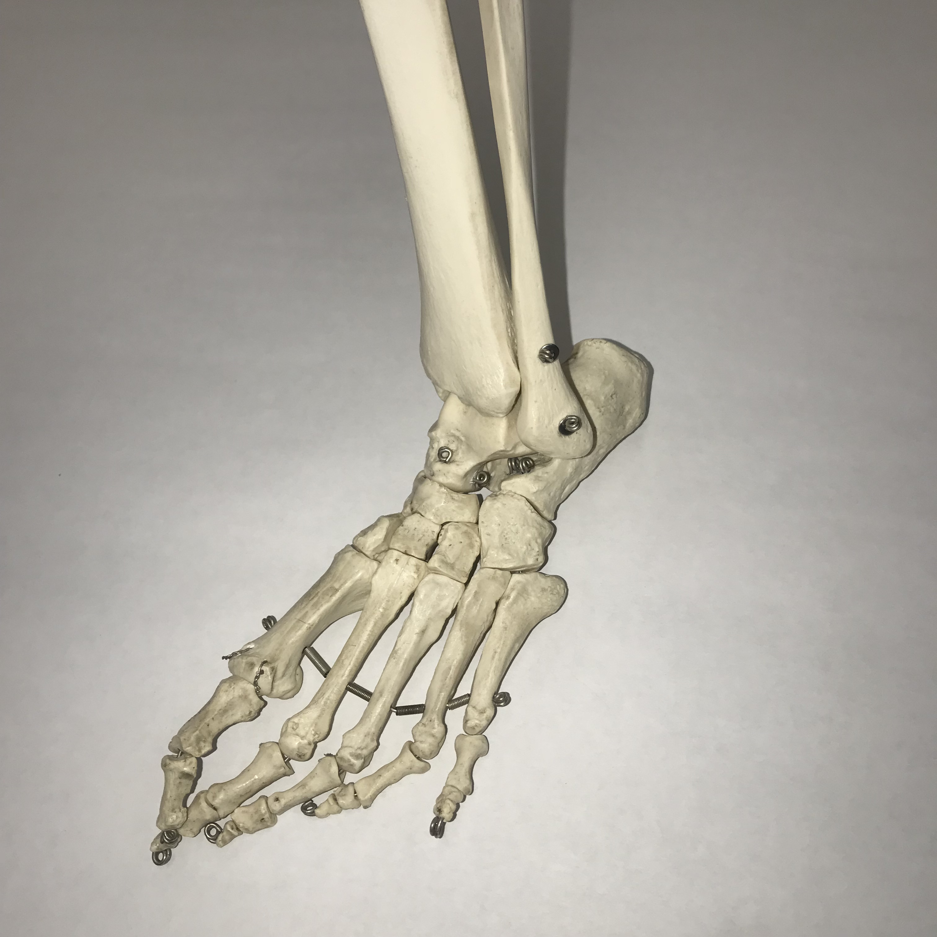
#23: Name one ligament that attaches to this bony feature.

Slide 25
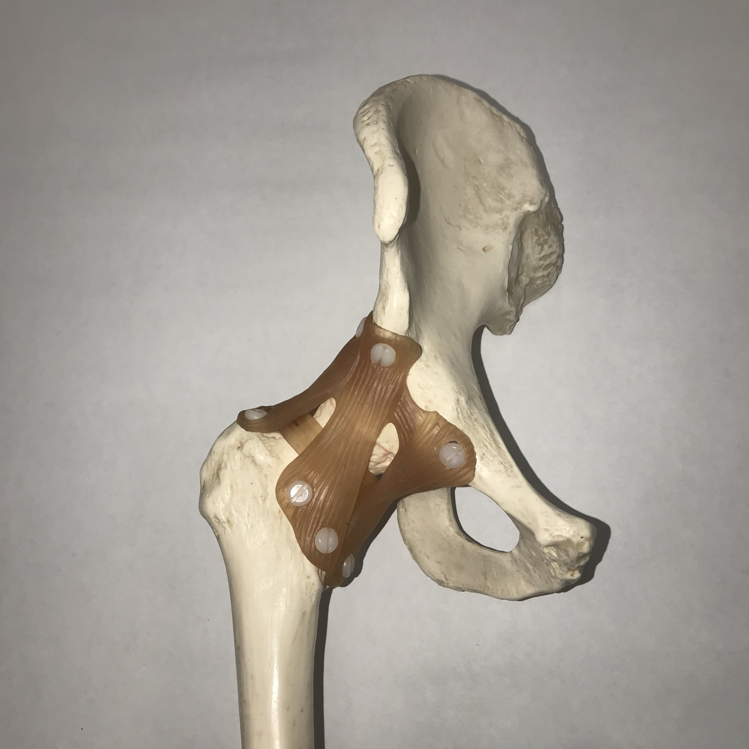
#24: Name this ligament.

Slide 26
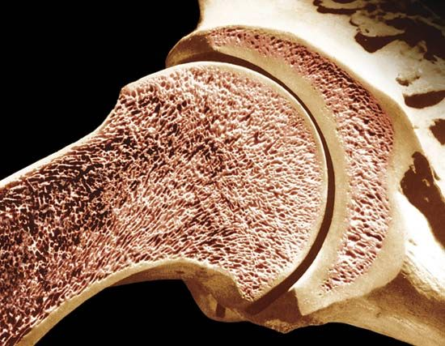
#25: What kind of bone cell would show abnormally high activity in an individual with osteoporosis?

Slide 27
KEY
13. Foramen lacerum
14. B
15. B
16. Possible: Mandible, ulna
17. Infraspinous fossa
18. Posterior Superior Iliac Spine (PSIS)
19. Navicular
20. Salt, ionic bonds
21. Scaphoid
22. Na+, Cl-
23. Anterior/posterior tibiofibular or talofibular, calcaneofibular
24. Iliofemoral
25. Osteoclast
1. Coronal suture
2. Tubercle of the rib
3. Pedicle of the vertebrae
4. Fibula
5. Manubrium of the sternum
6. Distal
7. Fibular/lateral collateral ligament
8. Amphiarthrosis
9. Arrector pili m.
10. Tibial tuberosity
11. Mastoid process of the temporal bone
12. Lipid/protein modification, vesicle formation and transport

